Slide 1
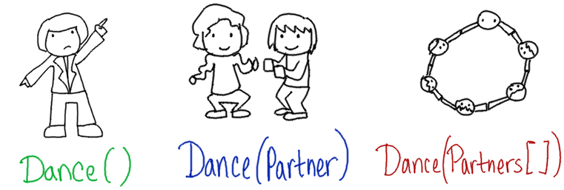
Function Overloading
& Operator Overloading
CS 201, Summer 2013

Slide 2
Function Overloading
Remember how, in Python, we could write a SumNumbers function, and it would work for integers and floats?
def SumNumbers( number1, number2 ):
return number1 + number2

Slide 3
Function Overloading
And C++ can't do that, because the parameters are defined as specific data-types -
Python
def SumNumbers( number1, number2 ):
return number1 + number2
C++
int SumNumbers( int number1, int number2 ) {
return number1 + number2
}

Slide 4
Function Overloading
C++ gets around this by using function overloading.
You can reuse a function name, so long as the function's parameter list is unique.
int SumNumbers( int number1, int number2 ) {
return number1 + number2
}
float SumNumbers( float number1, float number2 ) {
return number1 + number2
}

Slide 5
Function Overloading:
Unique Parameter Lists
A parameter list is unique if:
  There are different numbers of variables
  There are different datatypes for variables
  There is a different order of the variables
void DisplayInfo( string company );
void DisplayInfo( string name, int age );
void DisplayInfo( int age, string name );
void DisplayInfo( string name, float balance );
void DisplayInfo( Employee employee );

Slide 6
Example: OpenGL
OpenGL (A 3D graphics library) was written in C, which does not have function overloading.
(C also doesn't have classes)
C libraries are usable in C++.
A “library” is code that has been compiled to a .dll or other “lib” file. You can use the functionality in that lib.

Slide 7
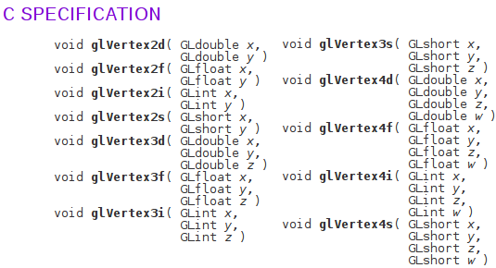
Example: OpenGL
In OpenGL, you can draw multiple vertices, which will form a polygon, a solid flat plane. However, there are multiple ways to specify these vertices:
From http://www.manpagez.com/man/3/glVertex3f/

Slide 8
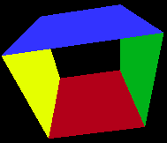
Example: OpenGL
Written this way, the user needs to remember which “glVertex” variant they want.
In C++, it could have all been under one “glVertex” name, and it would call a certain implementation of that function based on the parameters you gave it.
If it were implemented in C++:
void glVertex( float x, float y, float z );
void glVertex( float x, float y );
void glVertex( int x, int y, int z );
void glVertex( short x, short y );
Sample OpenGL program
for Code::Blocks

Slide 9
Creating an Overloaded Function...
To overload a function, you simply use the same Function Name and make sure the parameter list is unique for each implementation.
int Add( int number1, int number2 );
float Add( float money1, float money2 );
Fraction Add( Fraction fraction1, Fraction fraction2 );

Slide 10
Creating an Overloaded Function...
int Combine( int number1, int number2 ) {
return number1 + number2;
}
float Combine( float money1, float money2 ) {
float sum = money1 + money2;
sum = FormatCurrency( sum );
return sum;
}
Fraction Combine( Fraction fraction1, Fraction fraction2 ) {
Fraction common1 = fraction1;
Fraction common2 = fraction2;
common1.MultiplyNumAndDenom( fraction2.denominator );
common2.MultiplyNumAndDenom( fraction1.denominator );
Fraction sum = common1 + common2;
return sum;
}

Slide 11
Operator Overloading
Arithmetic operators like +, -, *, / are really just functions behind the scenes, with unique names.
Other overloadable operators are:
  stream operators << and >>
  subscript operator [ ]
  Comparison <, >, <=, >=, ==
  &&, ||
  ++, –
  Assignment =
  And more...

Slide 12
Operator Overloading
Operator Overloading would be used within a class, to specify how your custom object handles math (+, -, *, /), streaming (<<, >>), subscripts( [ ] ) and other things.

Slide 13
Operator Overloading
Why overload these operators?
  Writing a custom class and adding the functionality.
  Example: A fraction class with a numerator/denominator
    Would implement addition, subtraction, multiplication, and division
  Example: Your own list class
    Want to overload subscript [ ] operators to get a specific element.

Slide 14
Overloading Arithmetic
Declaration
In MyClass.h
class MyClass
{
public:
friend MyClass operator+( const MyClass& item1, const MyClass& item2 );
friend MyClass operator-( const MyClass& item1, const MyClass& item2 );
friend MyClass operator*( const MyClass& item1, const MyClass& item2 );
friend MyClass operator/( const MyClass& item1, const MyClass& item2 );
};
Implementation
In MyClass.cpp
MyClass operator+( const MyClass& item1, const MyClass& item2 )
{
// ...
}

Slide 15
Overloading Comparison
Declaration
In MyClass.h
class MyClass
{
public:
Friend bool operator==( MyClass& item1, MyClass& item2 );
Friend bool operator!=( MyClass& item1, MyClass& item2 );
Friend bool operator<( MyClass& item1, MyClass& item2 );
Friend bool operator>( MyClass& item1, MyClass& item2 );
Friend bool operator<=( MyClass& item1, MyClass& item2 );
Friend bool operator>=( MyClass& item1, MyClass& item2 );
};
Implementation
In MyClass.cpp
bool operator==( MyClass& item1, MyClass& item2 )
{
// ...
}

Slide 16
Overloading Streams
Declaration
In MyClass.h
#include <fstream>
class MyClass
{
public:
Friend ostream& operator<<( ostream& out, MyClass& item );
Friend istream& operator>>( istream& in, MyClass& item );
};
Implementation
In MyClass.cpp
ostream& operator<<( ostream& out, MyClass& item );
{
out << item.textField << endl;
return out;
}
istream& operator<<( istream& out, MyClass& item );
{
in >> item.loadedField;
}

Slide 17
Overloading Subscript
Declaration
In MyClass.h
class MyClass
{
public:
int& operator[]( const int index );
private:
int m_data[];
};
Note:
For Arithmetic, Stream, and Comparison, they did not belong to the MyClass class and were only friends of the MyClass class.
Here, the operator[ ] is part of MyClass.
Implementation
In MyClass.cpp
int& MyClass::operator[]( const int index );
{
return m_data[ index ];
}
Secondly:
The operator[ ] does not need to return an int, it will return whatever data-type you're wanting to access.

Slide 18
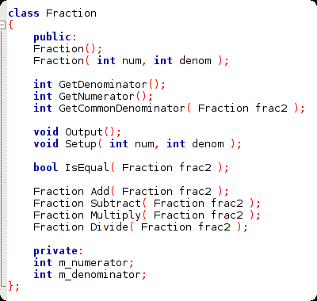
Let's Make Fractions!
We can make a fraction class that works without operator overloading.
This code is in the “Week 02” folder of the class website
https://github.com/Moosader/Problem-Solving-and-Programming-II

Slide 19
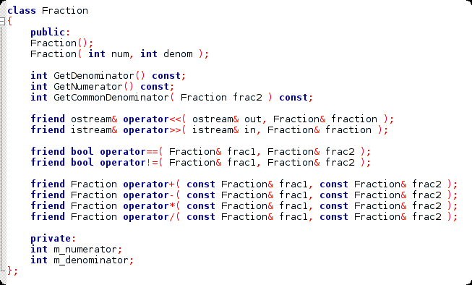
Let's Make Fractions!
Or we can utilize Operator Overloading

Slide 20
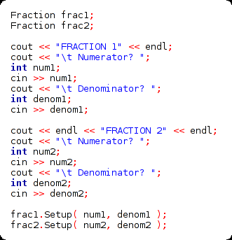
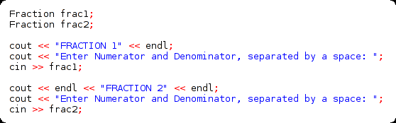
Let's Make Fractions!
Initializing the fractions
with Operator Overloading
We can overload the input stream operator so that it takes the numerator and denominator at the same time, and stores it directly in the fraction!
Initializing the fractions
without Operator Overloading

Slide 21
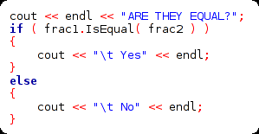
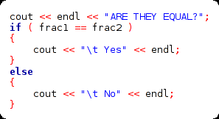
Let's Make Fractions!
Checking if equal
without Operator Overloading
Checking if equal
with Operator Overloading
Checking if the fractions are equal isn't any shorter if we overload the == operator
...But, using == is more consistent.
We compare ints and floats with ==,
so why not fractions, too?

Slide 22


Let's Make Fractions!
Arithmetic
without Operator Overloading
Arithmetic
with Operator Overloading
Doesn't it look kind of awkward to write
frac1.Add( frac2 ) ?

Slide 23
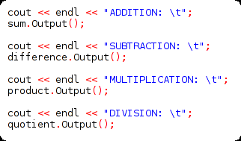
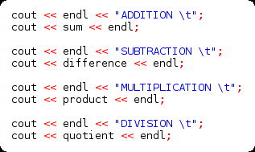
Let's Make Fractions!
Output
without Operator Overloading
Output
with Operator Overloading

Slide 24
ADDITIONAL READING
Function Overloading
  Chapter 4 of Pearson textbook
  http://www.learncpp.com/cpp-tutorial/76-function-overloading/
Operator Overloading
  Chapter 8 of Pearson textbook
  http://www.learncpp.com/cpp-tutorial/91-introduction-to-operator-overloading/
  http://www.cplusplus.com/doc/tutorial/classes2/

